Slide 1

@jessrudder youtube.com/compchomp
Notes:
Did you all enjoy lunch? Anyone go out and grab a coffee during the break? Yeah...some of you?
Many lifetimes ago, I worked as a barista at a popular coffee shop.
It was a mid-sized neighborhood store with a mix of traffic coming from the surrounding homes and businesses. We were actually right across the street from one of the big game studios so we'd always have a spike in business right before the next Call of Duty was supposed to be finished. It was a nice mix of customers and most of the regulars were great....but there was one....(there always is).

Slide 2
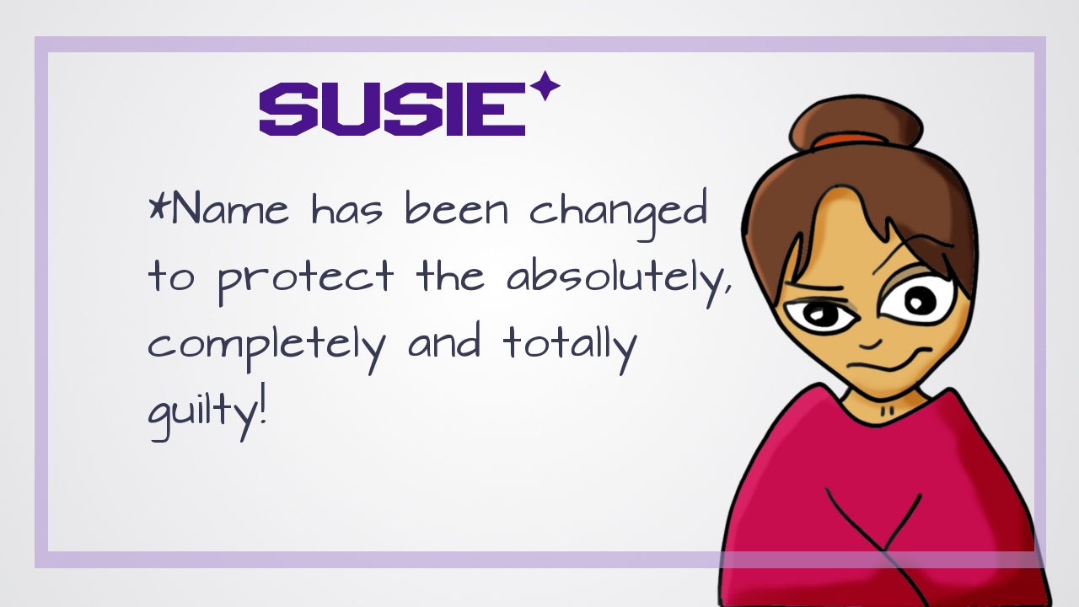
@jessrudder youtube.com/compchomp
Notes:
Susie would come in 3-4 times per week...and she always had the same order.

Slide 3

@jessrudder youtube.com/compchomp
Notes:
"Double espresso please"....
I'd make small talk as we finished the transaction...
"How's it going Susie?"
"*sigh* Oh...you know....not so well...."
She'd launch into some tale of woe...things that just weren't going well (mind you, she was a customer that was in 3-4 times per week and it was always the same deal).

Slide 4
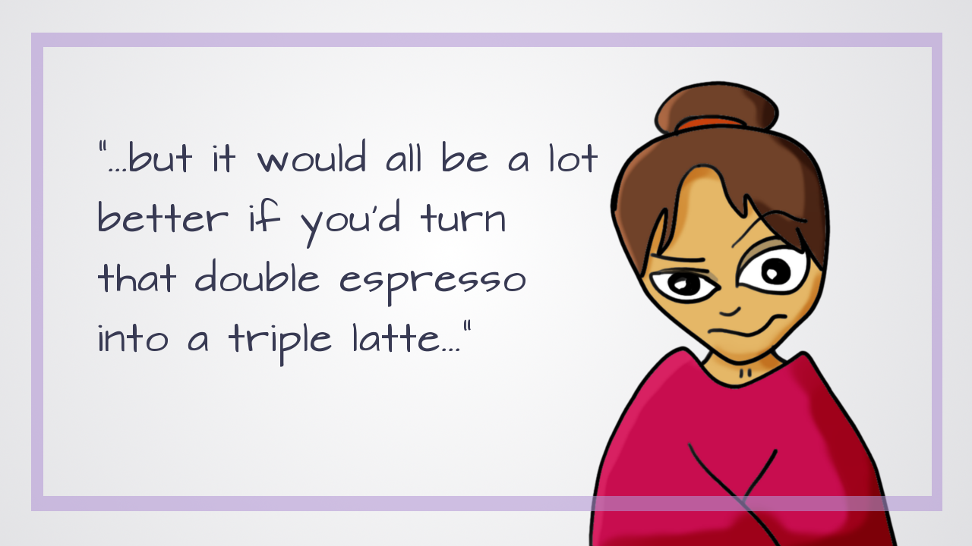
@jessrudder youtube.com/compchomp
Notes:
Then, right as I'd hand her the change, she'd perk up a bit and say, "But if you made that a triple latte instead, it'd be better..."
Every. Single. Time.

Slide 5
@jessrudder youtube.com/compchomp
Notes:
And the problem was that a double espresso cost about this much.

Slide 6

@jessrudder youtube.com/compchomp
Notes:
But a triple latte with its extra shot and milk….it cost this much...

Slide 7

@jessrudder youtube.com/compchomp
Notes:
…

Slide 8

@jessrudder youtube.com/compchomp
Notes:
…

Slide 9

@jessrudder youtube.com/compchomp
Notes:
She'd wait for the register to close...signaling that the transaction had officially come to an end. Then she'd try to sneak something else in there.

Slide 10

Notes:
Which brings me to our topic - safety and security in coffee shops.
Wait....that doesn't sound right....hmmm...maybe save that for a java conference.

Slide 11

Notes:
Well, we're a room full of (mostly) web developers. So, lets talk about security in web apps instead.

Slide 12

@jessrudder youtube.com/compchomp
Notes:
At the risk of stretching that coffee shop metaphor a bit too far, I'd argue that our web applications have a vulnerability that's very similar to the one Susie was exploiting.

Slide 13

@jessrudder youtube.com/compchomp
Notes:
SQL injection.

Slide 14
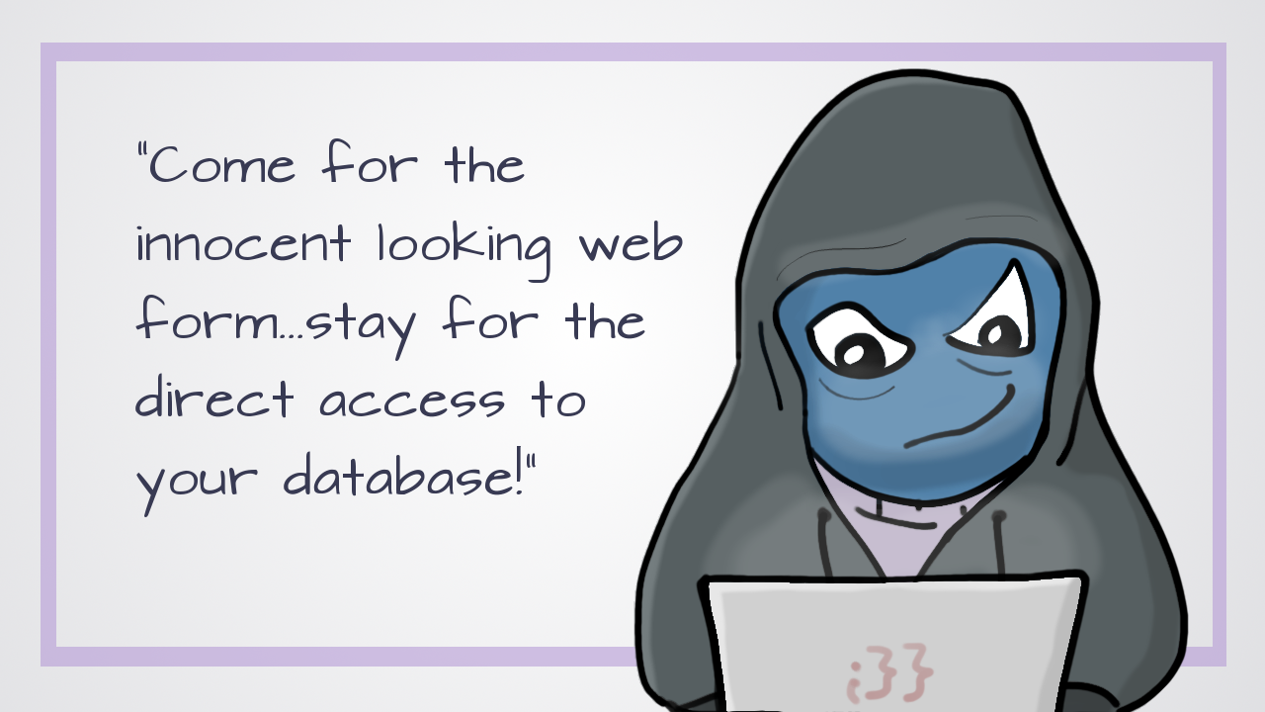
Notes:
We'll go into more detail in a minute, but, in brief, it's when someone closes out a legitimate transaction with your database then immediately tries to sneak more SQL commands in there so they can interact with your database and walk off with something a whole lot more valuable than coffee.

Slide 15

@jessrudder youtube.com/compchomp
Notes:
And, I know what you're thinking...."We're developers! There's nothing more valuable than coffee."

Slide 16
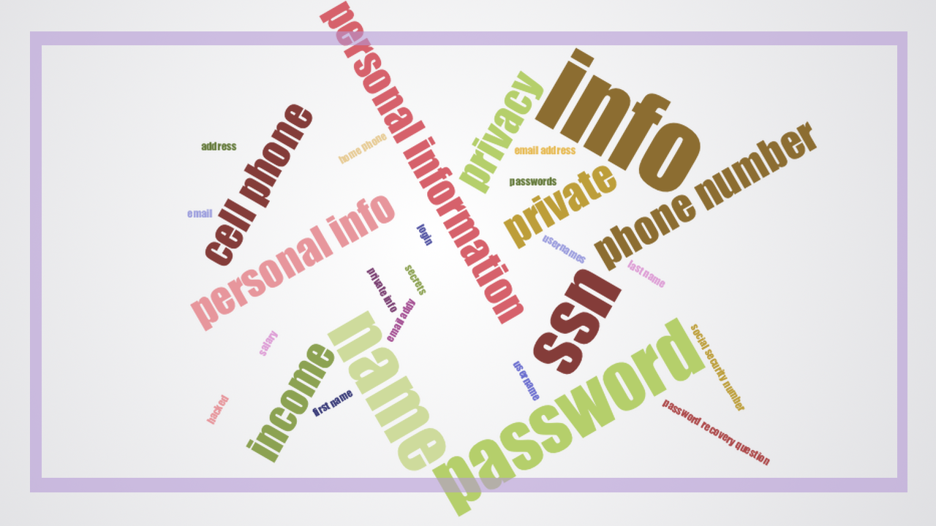
@jessrudder youtube.com/compchomp
Notes:
But, in this case, there is...it's your customer's private information.

Slide 17

@jessrudder youtube.com/compchomp
Notes:
When we talk about security vulnerabilities, we expect that we're talking about something new. A vulnerability that was just discovered in the past few weeks.

Slide 18

@jessrudder youtube.com/compchomp
Notes:
Something like Heartbleed where it's announced publicly the same day a patch is released.

Slide 19

@jessrudder youtube.com/compchomp
Notes:
SQL injection though...it's old enough to vote (in the U.S.)

Slide 20

@jessrudder youtube.com/compchomp
Notes:
The first public mention of it seems to have been by Jeff Forristal in an online hacker magazine called "Phrack" in 1998.

Slide 21

@jessrudder youtube.com/compchomp
Notes:
Jeff, who went by the hacker name of Rain Forrest Puppy...
Actually, let's pause here for a moment. While researching this I came across a lot of stories and news articles sporting people's hacker names and I realized - I haven't got a hacker name.

Slide 22

@jessrudder youtube.com/compchomp
Notes:
So I did what any reasonable web developer would do...I googled "Hacker Name Generators". I tried out a few different options (including one dubious one that insisted it needed to know my mother's maiden name in order to generate my hacker name...nice try) and I was the proud owner of this doozie:

Slide 23

@jessrudder youtube.com/compchomp
Notes:
Fire 4cid
You know it's a legit hacker name because they used a 4 instead of an A.

Slide 24
@jessrudder youtube.com/compchomp
Notes:
So, Rain Forrest Puppy had discovered that SQL databases (which were just starting to replace the then more popular Access databases) allowed batch commands

Slide 25

@jessrudder youtube.com/compchomp
Notes:
Instead of only being able to send one query through to the database each time it was opened….

Slide 26

@jessrudder youtube.com/compchomp
Notes:
You could open the connection to the database once and send a whole group of commands.
NBD because multitasking is good, right?

Slide 27

Notes:
Perhaps I want to be able to look at all of my employees

Slide 28

Notes:
And select just the ones that are engineers

Slide 29

@jessrudder youtube.com/compchomp
Notes:
then average their chips_consumed

Slide 30

@jessrudder youtube.com/compchomp
Notes:
(or, if you're joining us from places that speak that other english - chips_consumed).

Slide 31

@jessrudder youtube.com/compchomp
Notes:
Which, in both cases is...high. We'll leave it at that.

Slide 32

@jessrudder youtube.com/compchomp
Notes:
This is all well and good in closed systems.

Slide 33

@jessrudder youtube.com/compchomp
Notes:
However, when you have input coming from outside users heading straight into your database...well, things get a little dicy.

Slide 34
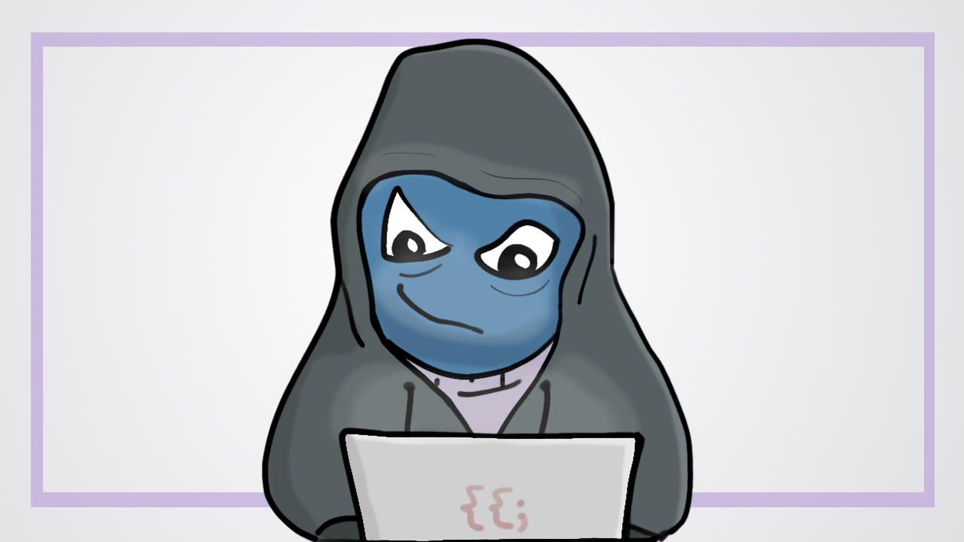
@jessrudder youtube.com/compchomp
Notes:
A shady character...like this one....could user your innocent little web form to gain access to parts of your database you didn't want them to have by piggy backing their own SQL requests onto your intended request....like so.

Slide 35
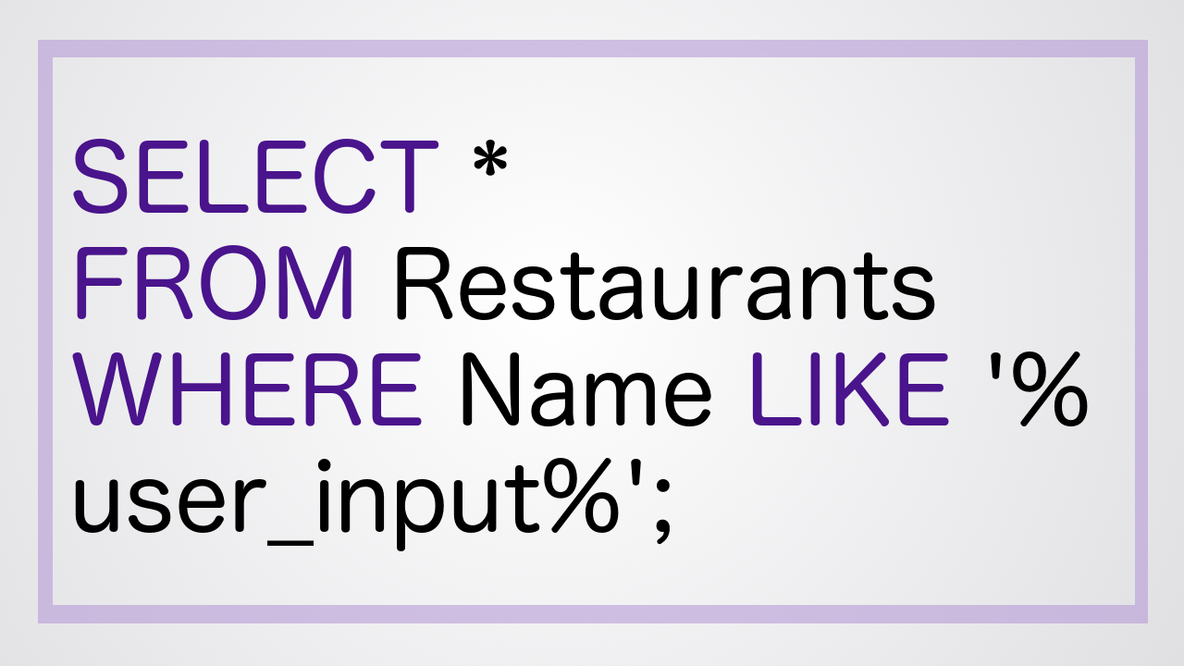
@jessrudder youtube.com/compchomp
Notes:
You kindly provide your users with the ability to search for a restaurant even when they only know part of the name:
SELECT "restaurant".* FROM "restaurants" WHERE ("name LIKE '%user_input%');

Slide 36

@jessrudder youtube.com/compchomp
Notes:
And shady mcshadester searches for the following restaurant (which doesn't sound so great to me):
'); DELETE FROM Restaurants --

Slide 37
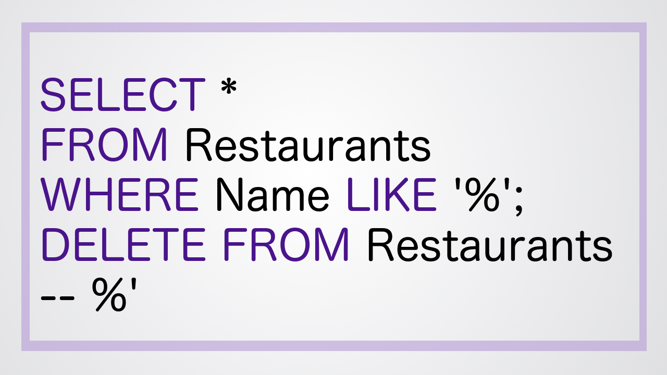
@jessrudder youtube.com/compchomp
Notes:
Which gives us the following SQL query:
SELECT "restaurant".* FROM "restaurants" WHERE (name LIKE '%'); DELETE FROM Restaurants -- %’)
And, suddenly, your entire restaurant table is gone....

Slide 38

@jessrudder youtube.com/compchomp
Notes:
not your table at the restaurant...your restaurant table in your database.

Slide 39

@jessrudder youtube.com/compchomp
Notes:
Though you should probably cancel those reservations because you're going to be spending the rest of the night restoring your database from backups. You do have database backups, right? Not really our topic today...but generally a good idea.

Slide 40

@jessrudder youtube.com/compchomp
Notes:
so, yeah...SQL injection....it has been on people's radar for at least 18 years and yet it regularly ranks at the top of OWASPs (Open Web Application Security Project) 10 most critical web application security risks. And that is a top 10 list you don't want to be at the top of.
In fact, a quick scan of recent news will give you plenty of examples of SQL injection in action.

Slide 41

@jessrudder youtube.com/compchomp
Notes:
In June 2011 sonypictures.com lost the data of over 1,000,000 users,

Slide 42
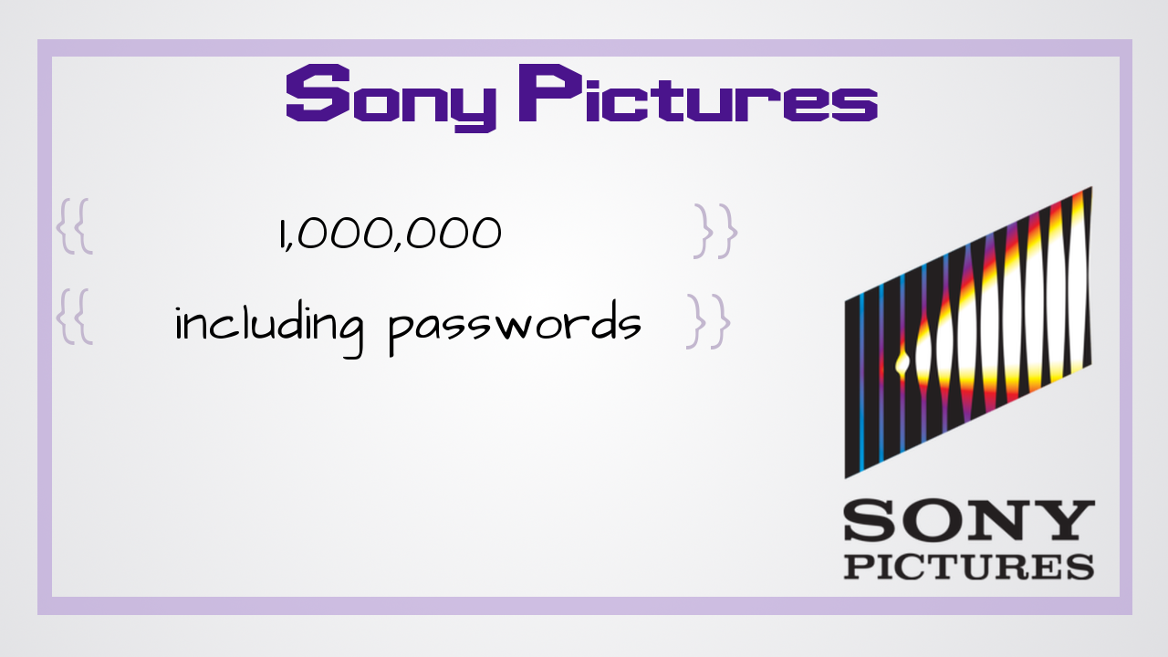
@jessrudder youtube.com/compchomp
Notes:
Including passwords

Slide 43
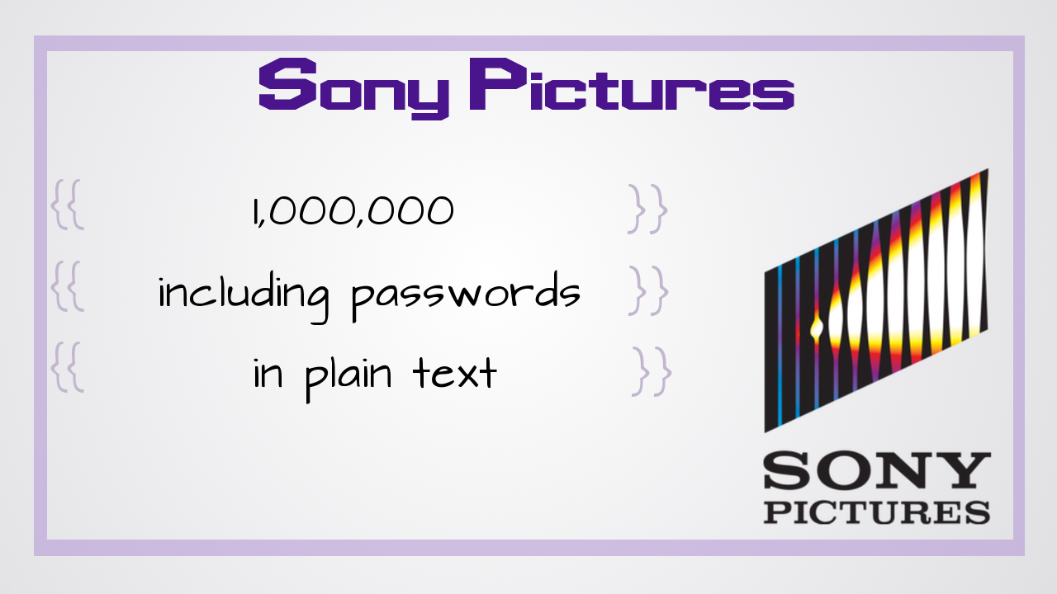
@jessrudder youtube.com/compchomp
Notes:
that were reportedly stored in plain text. Ouch!

Slide 44

@jessrudder youtube.com/compchomp
Notes:
In October of 2012, hackers used SQLi to get the personal records of thousands of students

Slide 45

@jessrudder youtube.com/compchomp
Notes:
from 53 universities including Harvard, Stanford, Princeton and other top universities around the world.

Slide 46

@jessrudder youtube.com/compchomp
Notes:
It turns out that student info is highly sought after due to a combo of pristine credit records and lack of watching their credit scores. I guess that's one positive side effect of crushing student debt...by the time you graduate, no one wants to steal your identity any more.

Slide 47
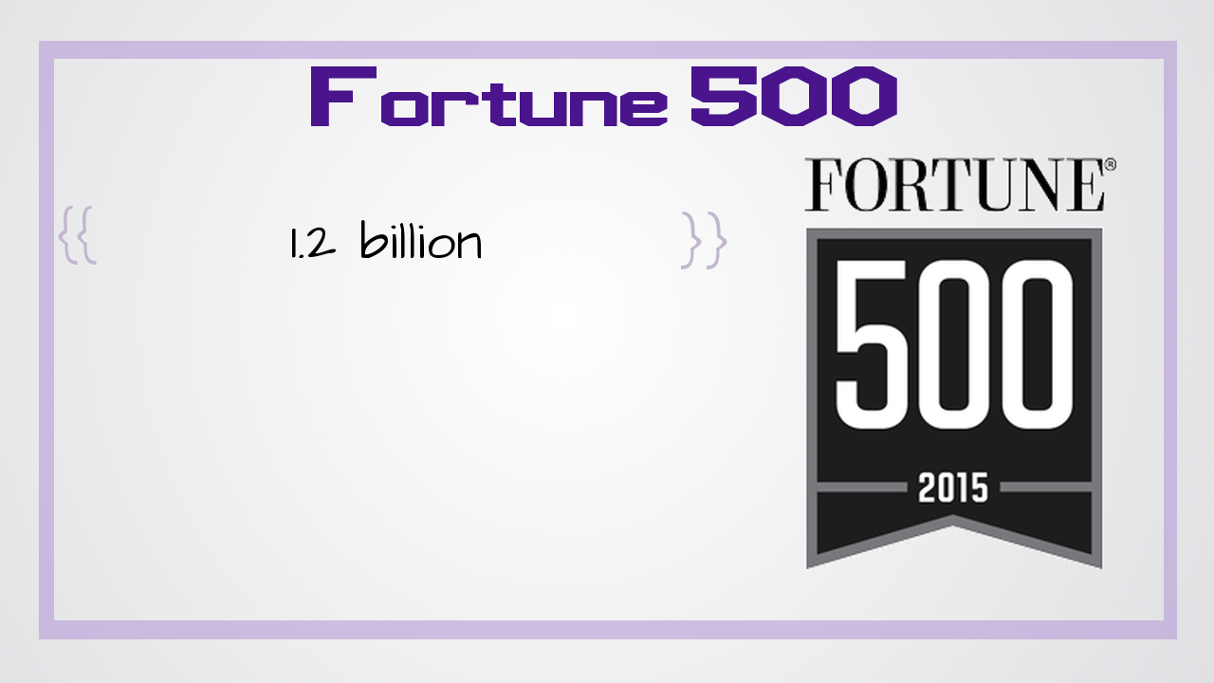
@jessrudder youtube.com/compchomp
Notes:
In August 2014, Russian hackers stole 1.2 billion username and password combinations

Slide 48
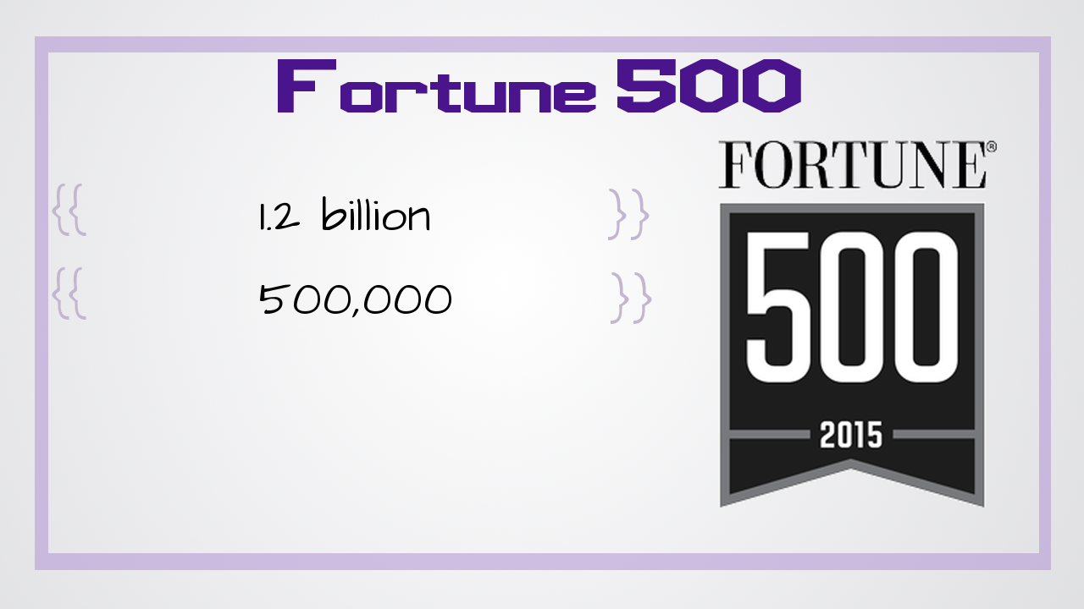
@jessrudder youtube.com/compchomp
Notes:
and 500,000 email addresses from

Slide 49

@jessrudder youtube.com/compchomp
Notes:
400,000 sites. These weren't just small sites made by your cousin's best friend's uncle's kid who sort of knows how to code. Some of these sites were for Fortune 500 companies. And this wasn't pulled off by some uber-sophisticated, high tech gang of hackers - it's a group of less than a dozen men in their 20s in a small city in Russia...they actually started out as email spammers.

Slide 50

@jessrudder youtube.com/compchomp
Notes:
More recently in November 2015, an electronic toy company VTech was hacked and the personal data of 5 million parents

Slide 51

@jessrudder youtube.com/compchomp
Notes:
and 200,000 was taken.

Slide 52

@jessrudder youtube.com/compchomp
Notes:
What makes it worse is that the kids accounts can be linked to the parents which means you basically have first and last names and home addresses of a bunch of kids as well.

Slide 53

@jessrudder youtube.com/compchomp
Notes:
That's a small sample of some of the major hacks over the past 5 years. There are so many more to choose from!

Slide 54

@jessrudder youtube.com/compchomp
Notes:
Hacks that affected the New York Times,

Slide 55

@jessrudder youtube.com/compchomp
Notes:
Target

Slide 56

@jessrudder youtube.com/compchomp
Notes:
, Sony (again),

Slide 57

@jessrudder youtube.com/compchomp
Notes:
the U.S. Army

Slide 58

@jessrudder youtube.com/compchomp
Notes:
and even the Department of Homeland Security!

Slide 59

Notes:
So what's the deal, is there some elite Hacker Havard out there teaching the world's greatest hackers how to sneak unwanted SQL commands into our databases like sneaky little code ninja?
In a word....nope.
SQL injection is common for two reasons.

Slide 60

@jessrudder youtube.com/compchomp
Notes:
he first is that it's easy to automate. There are scripts you can buy that will just bounce around the internet testing web forms and URLs to see which ones are vulnerable. Once a site is found, the same basic techniques can be used to get access to your data.

Slide 61

@jessrudder youtube.com/compchomp
Notes:
Troy Hunt (a web security expert that runs haveibeenpwned.com (a site that lets you know if your data was found in leaked/hacked data)

Slide 62
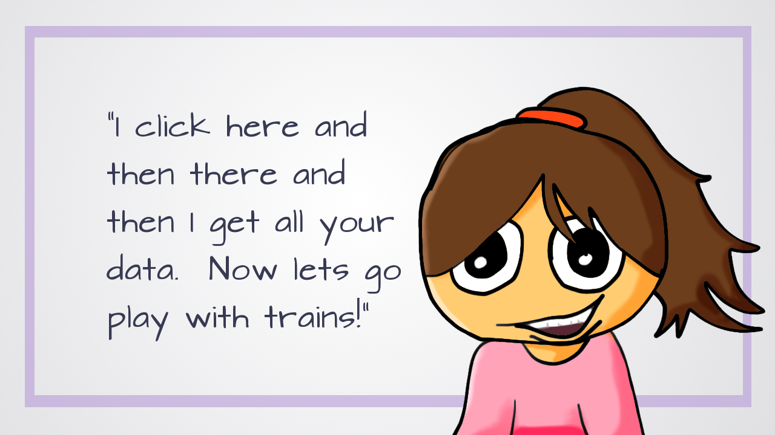
Notes:
has a video showing him teaching his then 3-year-old to do a SQLi attack using one of the most popular programs. This thing has a gui and everything...you don't even have to know how to use the command line!

Slide 63

@jessrudder youtube.com/compchomp
Notes:
The second is that it keeps working. Hackers continue to use it because even though we've known about it for 18 years, they're still getting gigs and gigs worth of valuable personal data from our web apps.
So, how do we put an end to this?

Slide 64

@jessrudder youtube.com/compchomp
Notes:
It's a bit tough to make SQLi harder to automate. I suppose you could give your tables weird names like "X[08?gY&" instead of "Users" so people can't guess your table names but that only protects you from some injection and will drive the developers on your team insane.
The easier route is making sure it doesn't work.
Awesome. This talk is over!
Wait...you want to know how to make sure it doesn't work.
Fine...if you insist.

Slide 65

@jessrudder youtube.com/compchomp
Notes:
My name is Jessica and I work at the Flatiron School.

Slide 66

@jessrudder youtube.com/compchomp
Notes:
I help build Learn - an online platform for teaching people how to code. Part of our teaching philosophy is to have people build the tools they'll be using later - it helps to ensure that they understand what's happening under the hood. In our web development program, our students have to work with SQL and build their own light-weight ORMs. After suffering through this for a while, we introduce them to ActiveRecord - which seems like magic!

Slide 67
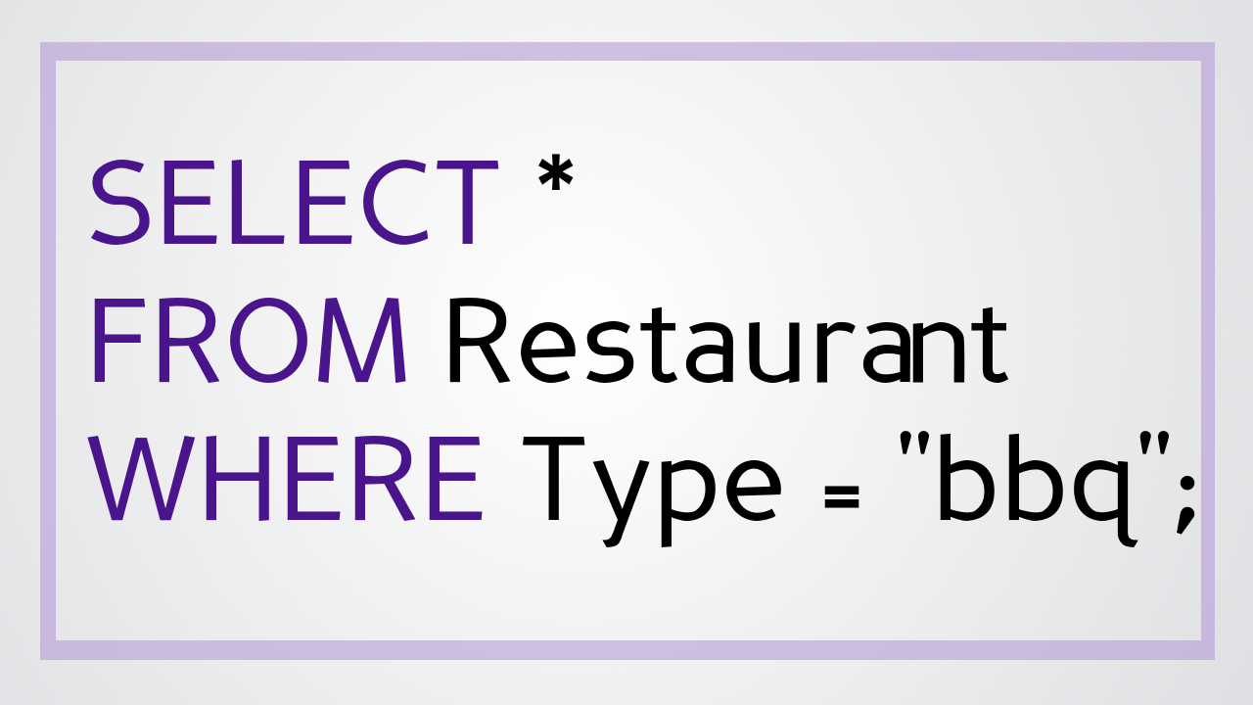
@jessrudder youtube.com/compchomp
Notes:
No more:
SELECT * FROM "restaurants" WHERE type = "bbq"

Slide 68
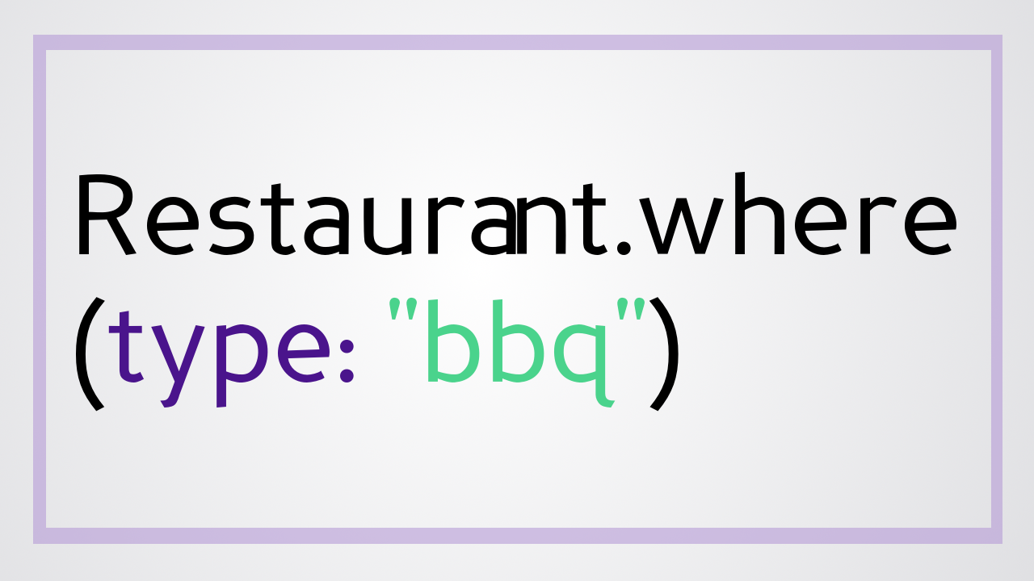
@jessrudder youtube.com/compchomp
Notes:
Instead:
Restaurants.where(type: "bbq")

Slide 69
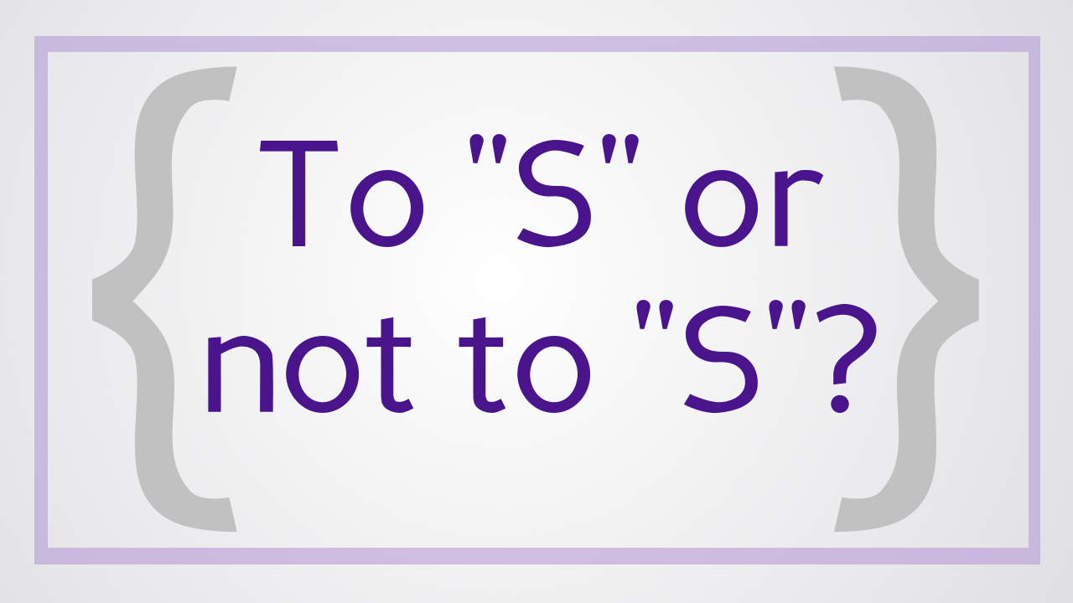
@jessrudder youtube.com/compchomp
Notes:
And because there's so much magic involved, it's easy to to think that everything has been covered. The only thing you need to worry about is remembering whether the rails convention is for a model to be singular or plural....but it's a bit more complicated than that.

Slide 70

Notes:
Alright - we're at Rails Conference and you came to a talk titled "Will It Inject? A Look at SQL Injection and ActiveRecord"...and congratulations for making it all the way to the title slide. And, given this title, I think it's safe to assume you're interested in hearing about this from an ActiveRecord perspective.
But having someone yack at you about security (especially right after lunch) can be boring...so instead we're going to play a little game I like to call

Slide 71

@jessrudder youtube.com/compchomp
Notes:
"Will It Inject?!?" The rules are simple…I'll show you an ActiveRecord method and you can tell me whether or not you think it's vulnerable to SQL injection. Feel free to play along if you're watching this at home...just shout it right out at the monitor. I won't judge.

Slide 72
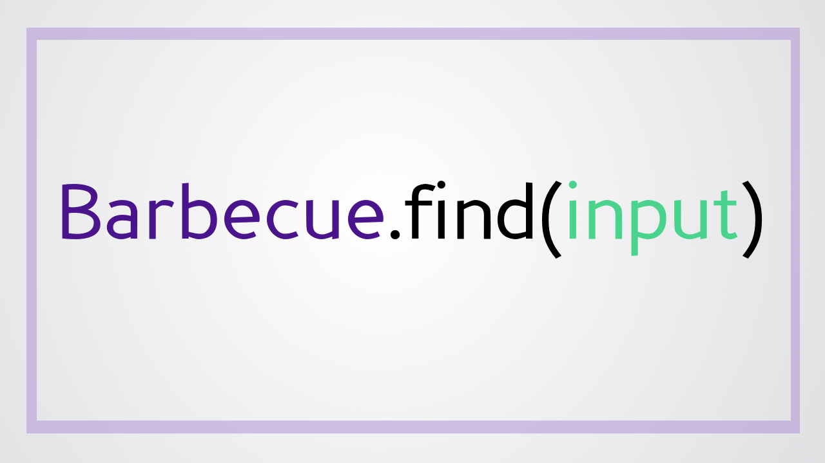
@jessrudder youtube.com/compchomp
Notes:
Let’s start with “find”. Find is sort of the heavyweight of the ActiveRecord world. If your app uses ActiveRecord, chances are you have this particular query all over the code.

Slide 73
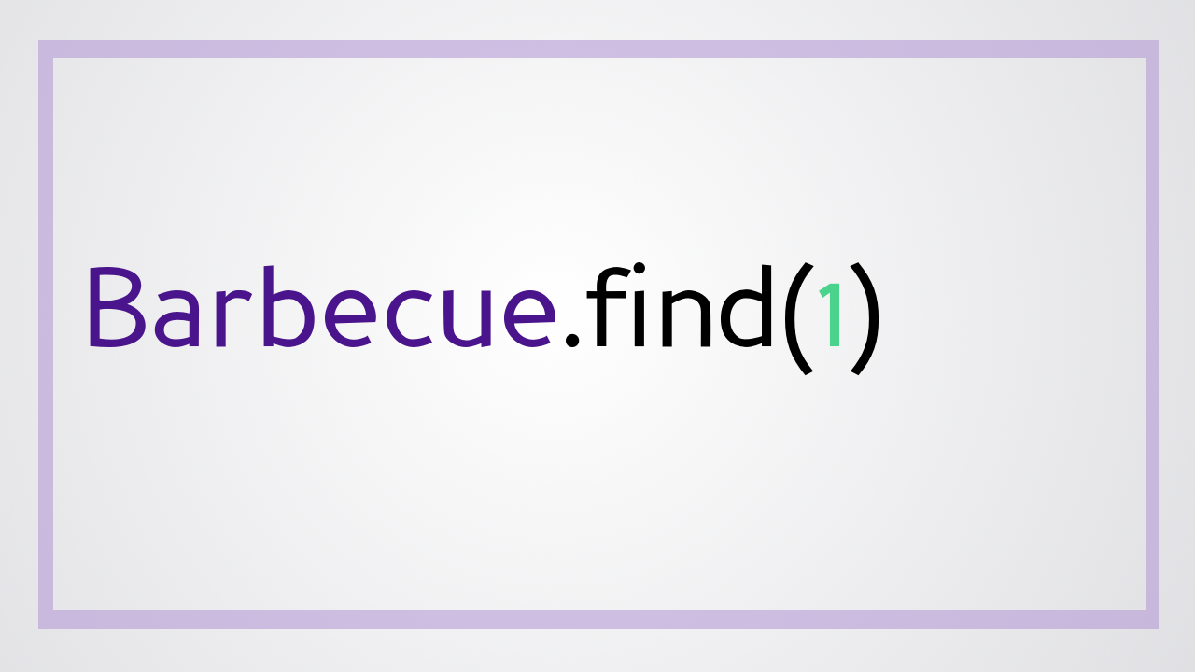
@jessrudder youtube.com/compchomp
Notes:
It’s used to look up a record by it’s database id….So, will this inject?

Slide 74

@jessrudder youtube.com/compchomp
Notes:
No! This one is safe. It will only work for an integer that matches a record in the database, so, raw sql would cause an error. However, someone could mess around with the number and still get access to records they shouldn’t have access to. So make sure you’re checking if the current user should have access to the record. That’s outside of the scope of this talk though, so I’m going to move right along….

Slide 75
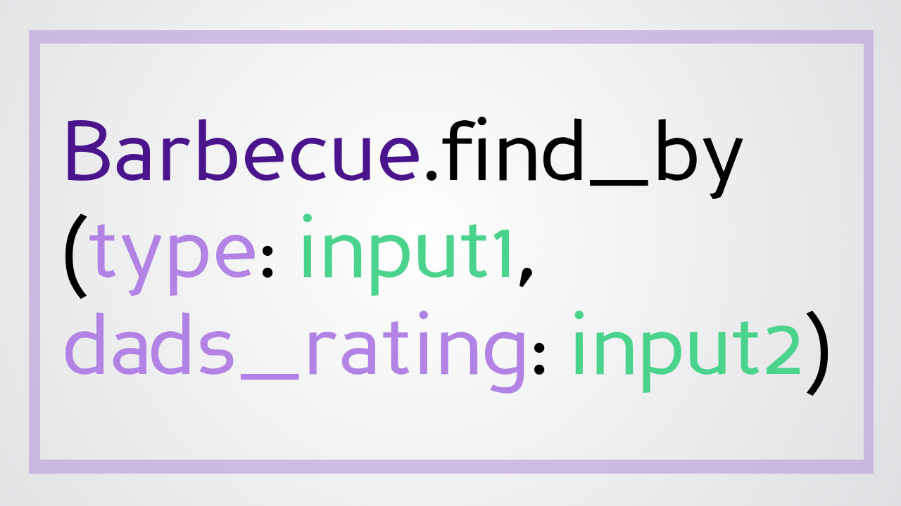
@jessrudder youtube.com/compchomp
Notes:
Find_by (also known as where)…it’s similar to find, but you pass in both the attribute you’re searching on as well as the value you want that attribute to have. And, as you can see here, find_by allows you to specify the values of multiple attributes.

Slide 76
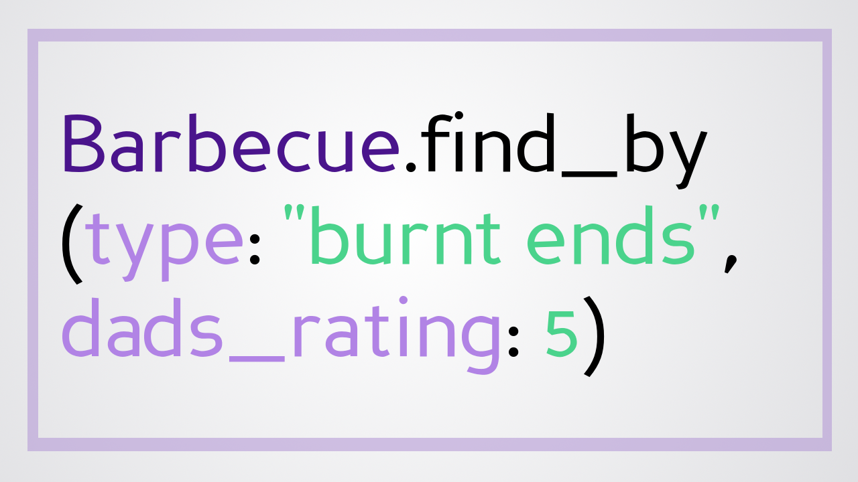
@jessrudder youtube.com/compchomp
Notes:
So, you could search your database for a barbecue joint that serves burnt ends and scores a 5 on “Dad’s Rating”. If you know my dad, you know that this can only possibly refer to one place – Arthur Bryants. But whether you know my dad or not, will this inject?

Slide 77
@jessrudder youtube.com/compchomp
Notes:
It will not inject! When you pass in attributes as a hash, ActiveRecord escapes special characters and treats the entire thing like a string. Pass in all the raw sql you want, it won’t execute.

Slide 78
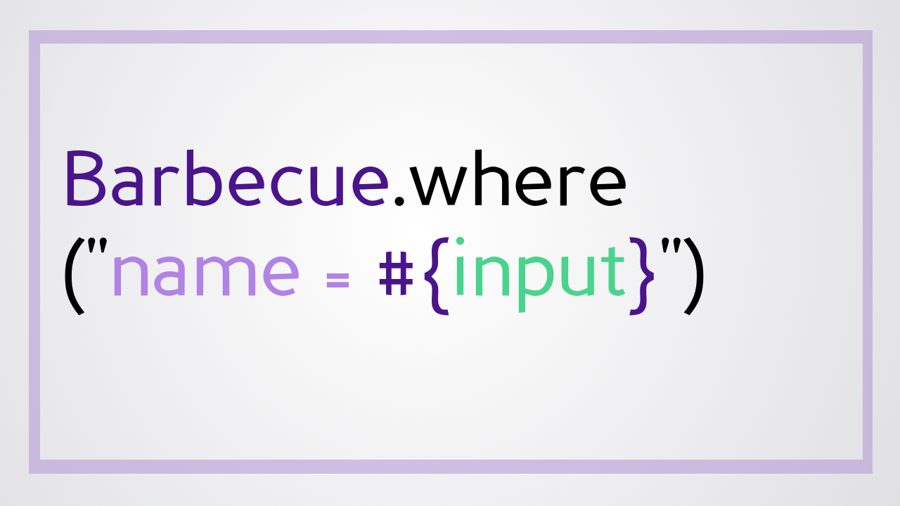
@jessrudder youtube.com/compchomp
Notes:
But what if you decided to write a where query that searches for records based on a sql fragment? In this case, you’re allowing the user to specify the name of the Barbecue joint…..

Slide 79
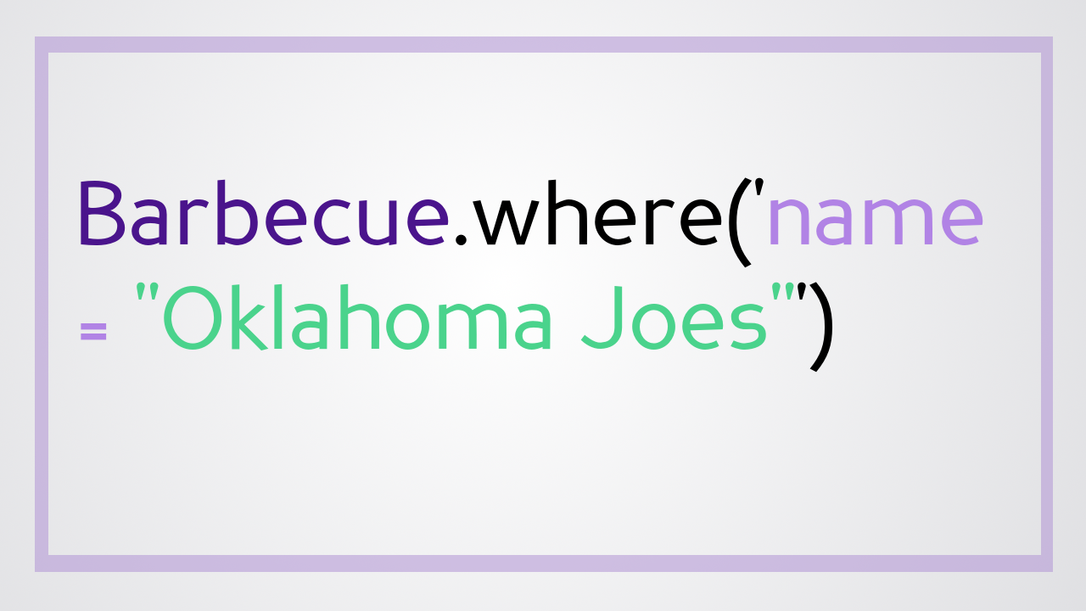
@jessrudder youtube.com/compchomp
Notes:
So, if they wanted to, they could search for Oklahoma Joes (another fine establishment that became even finer when it changed it’s name to Joes Kansas City barbecue). A great place for barbecue, but, how does it fare against sql injection…..

Slide 80

@jessrudder youtube.com/compchomp
Notes:
Eeeeehn….not so well.

Slide 81
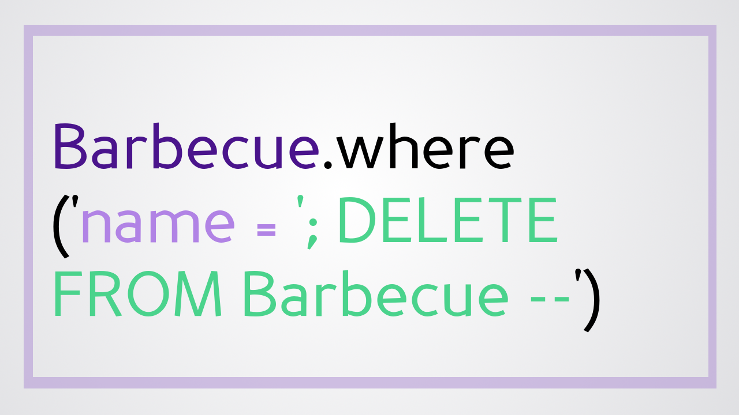
@jessrudder youtube.com/compchomp
Notes:
In this instance, where allows you to pass in sql fragments and you’re passing in whatever your user gives you. So if your user searches for the restaurant called – single quote, semi colon, DELETE FROM Barbecue dash dash (which, between you and me does not sound like a place with great food), the end result is that you lose your entire Barbecue table. Womp womp! So how do we protect ourselves?

Slide 82
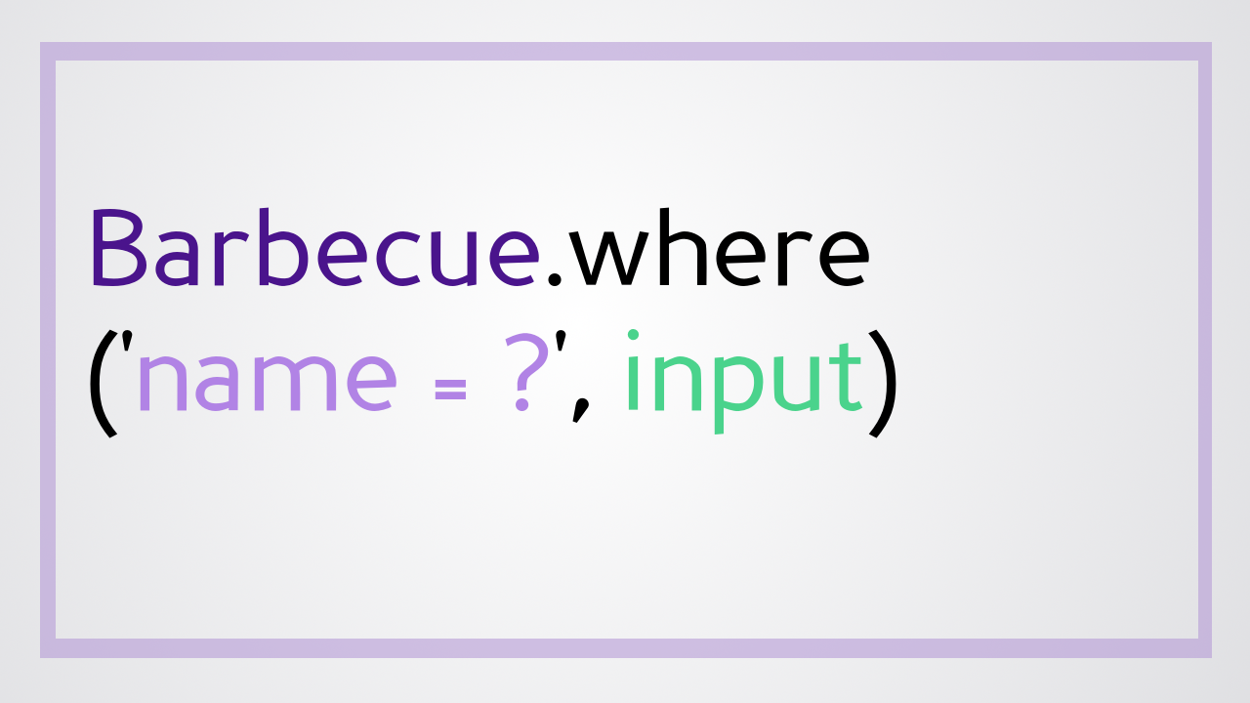
@jessrudder youtube.com/compchomp
Notes:
You do it like this! Any time you’re using raw sql, when you get to the point in the query where you’d put the user supplied data, replace it with a question mark followed by the input.

Slide 83

@jessrudder youtube.com/compchomp
Notes:
ActiveRecord then steps in and starts the digital equivalent of baby-proofing the query for you.

Slide 84

@jessrudder youtube.com/compchomp
Notes:
One thing that ActiveRecord will do is sanitize the user input which means it escapes all the special characters and turns the user input into just a string.
That magic happens in active_record/sanitization.rb with help from quoting.rb No matter what nefarious things people pass into your app, by the time it hits your database, it’s nothing more than a string.

Slide 85

@jessrudder youtube.com/compchomp
Notes:
The other thing that happens when you use ‘parameterized queries’ is that the sql statement gets sent to the database with placeholders for the question marks. The database will then parse the statement and come up with a “query plan” that is cached for future use. A token is sent back to the app representing that query plan. When the actual values finally come through, the app sends the query token and the values to the database. This adds extra security because the database won't veer off the pre-set path. All of the input from the user is treated as simple statements….no matter what they say, they can’t change the type of query that was already planned.
Now, not all databases support this, so the ActiveRecord database adapter actually determines how to handle things when you use perameterized queries. Make sure you know how it works for your particular database.

Slide 86
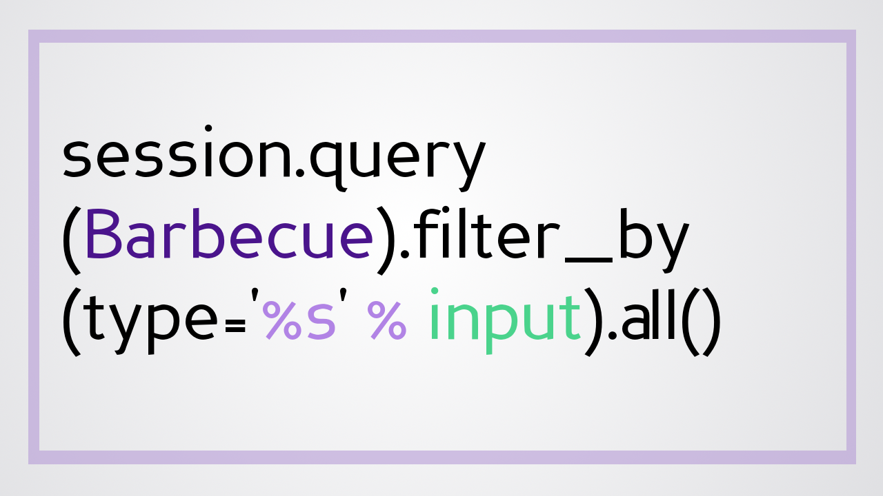
@jessrudder youtube.com/compchomp
Notes:
Alright….back to the game. We’re going to step it up a notch....will this inject?

Slide 87

@jessrudder youtube.com/compchomp
Notes:
Will it inject? This isn't even ActiveRecord...it's Python (using SQLAlchemy). I’m just trying to make sure you’re all awake.

Slide 88
@jessrudder youtube.com/compchomp
Notes:
Though, if your curious, that particular statement wouldn’t inject because ‘filter_by’ automatically escapes special character in user input.

Slide 89
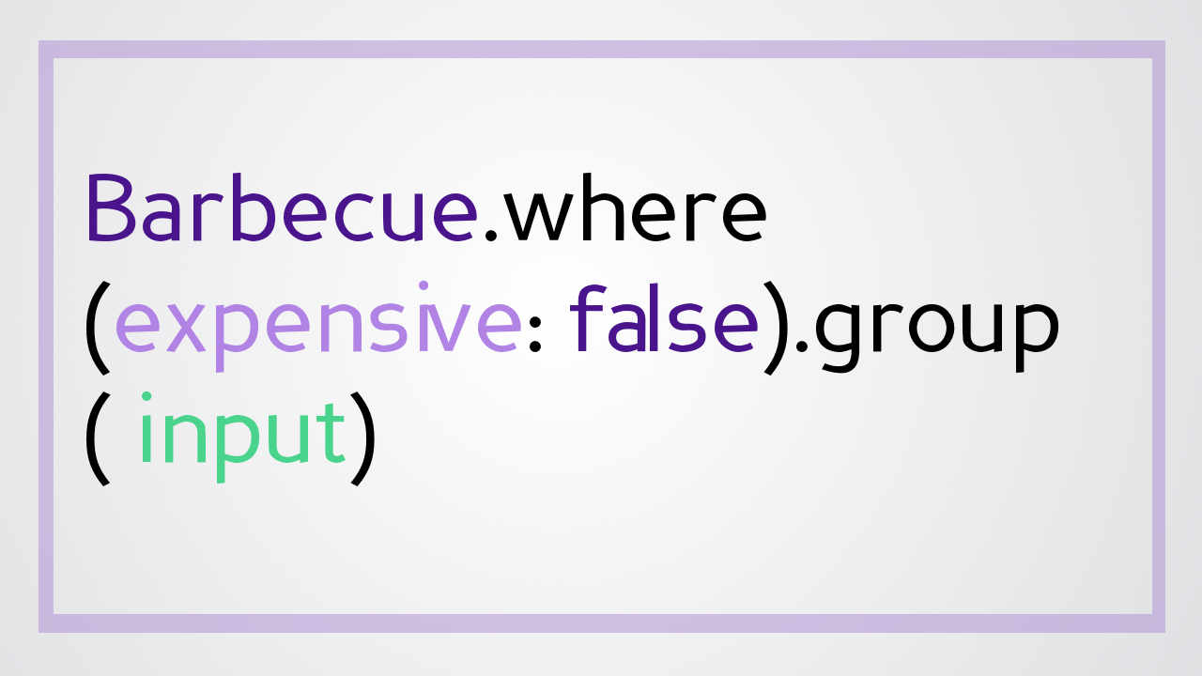
@jessrudder youtube.com/compchomp
Notes:
What if you wanted to search for all barbecue joints that are NOT expensive…but, to make it easier to determine which ones are delicious,

Slide 90
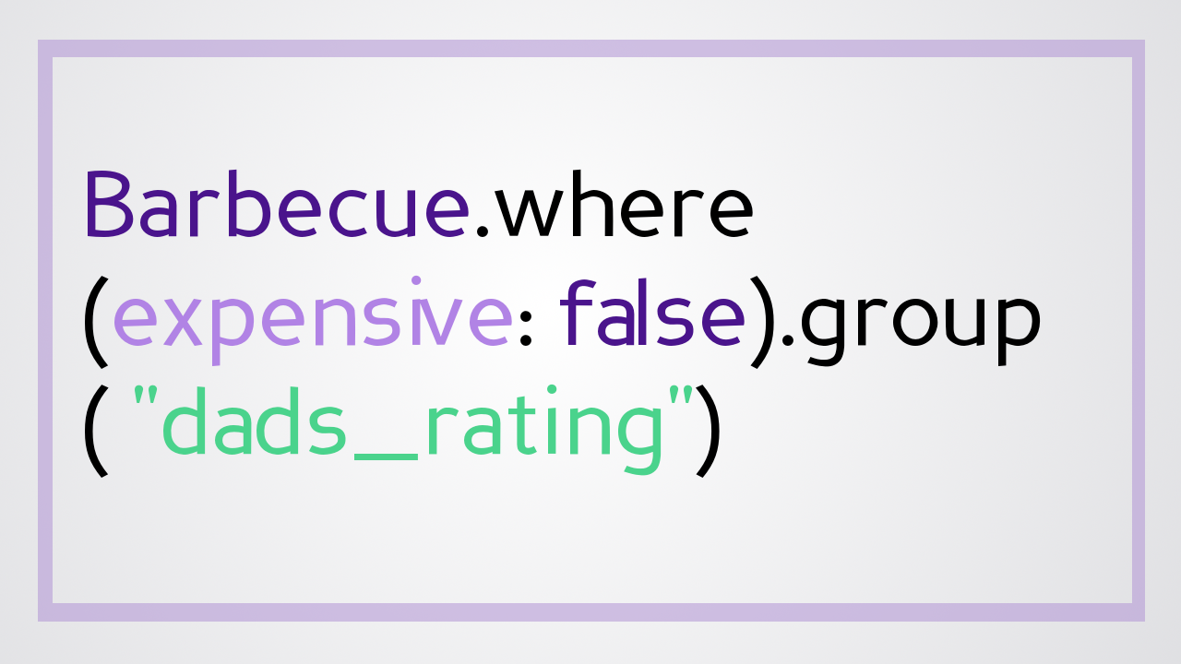
@jessrudder youtube.com/compchomp
Notes:
You group by dads_rating. Is this vulnerable to sql injection?

Slide 91
@jessrudder youtube.com/compchomp
Notes:
Yes! The group method allows for sql to be passed in so if you’re putting user data directly into the query, you’re at risk of being hacked.

Slide 92
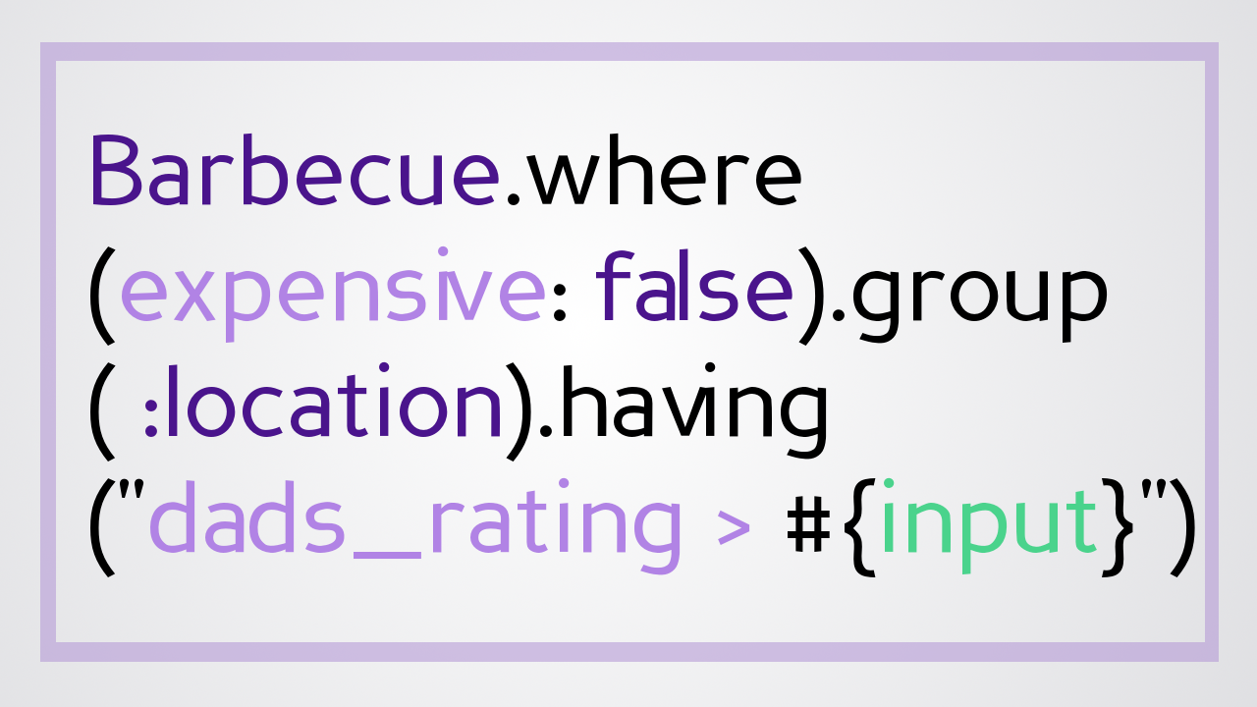
@jessrudder youtube.com/compchomp
Notes:
Alright….I think we have time for one more. Let’s take a look at having....This one usually ends up at the end of a chain of other selection criteria.

Slide 93
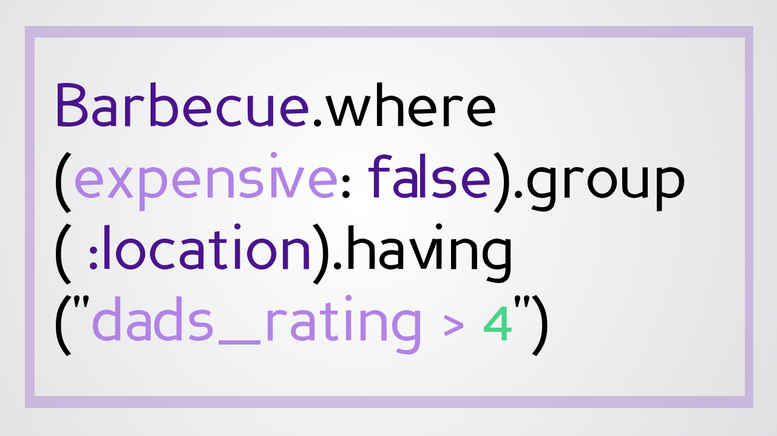
@jessrudder youtube.com/compchomp
Notes:
In this case we’re looking for barbecue restaurants that aren’t expensive and we want to group the by location; however, we only want the ones that have a “dads_rating” greater than the value specified by the user. Will it inject?

Slide 94
@jessrudder youtube.com/compchomp
Notes:
You know it! The #having method is at greater risk than many other methods because it accepts sql AND it’s usualy at the end of the sql statement chain. That makes it easier for people to shove their own sql in there and have it work.

Slide 95
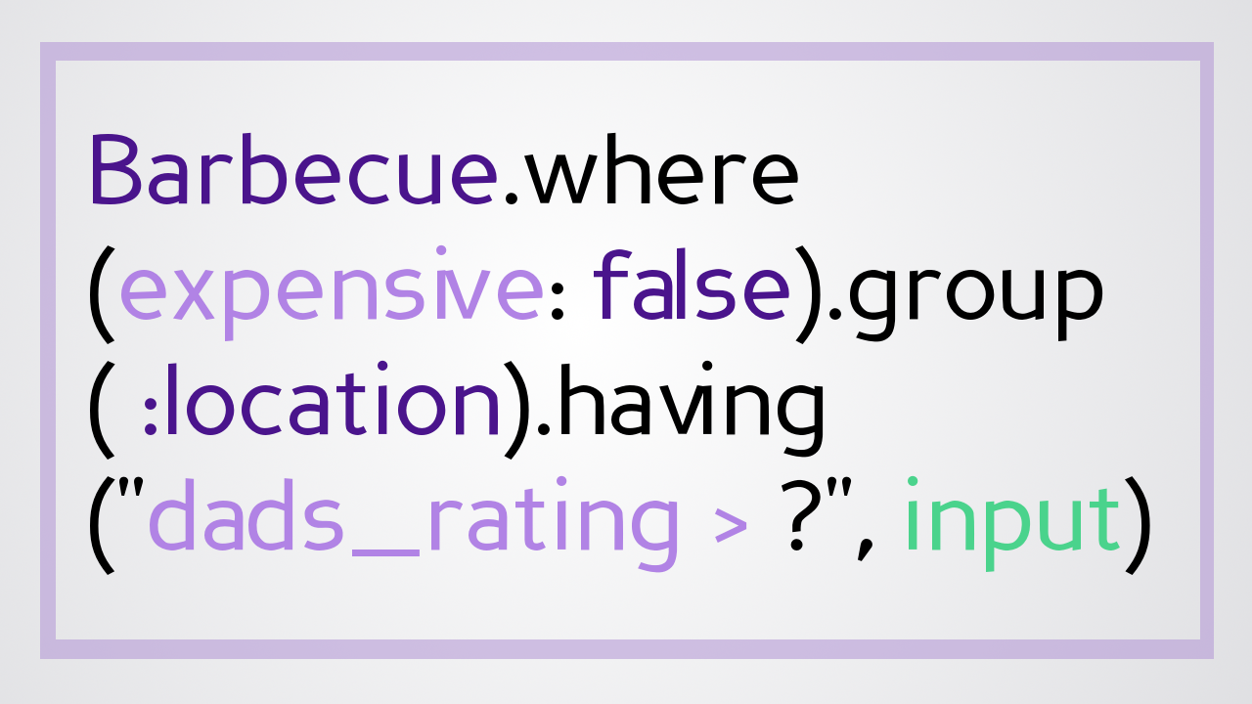
@jessrudder youtube.com/compchomp
Notes:
But, this is easily fixed with parameterized queries (just the same as the #where method). And that’s one of the other great things about ActiveRecord is that if you spend just a bit of time with it, you’ll start to see patterns emerge. In almost every instance where you put your data at risk by taking in user input, you can keep things safe by following the parameterized query patter. Easy peasy.

Slide 96

@jessrudder youtube.com/compchomp
Notes:
Some of you may be thinking, if people are aware of these vulnerabilities, why hasn't it been fixed? I'll go back to my hotel room tonight, write the patch and open a PR! If only it were that simple.

Slide 97

@jessrudder youtube.com/compchomp
Notes:
This is yet another example of that age old tension between freedom

Slide 98

@jessrudder youtube.com/compchomp
Notes:
and security. Those vulnerabilities are there to allow us flexibility.

Slide 99
@jessrudder youtube.com/compchomp
Notes:
The coffee shop I worked at gave baristas wide lattitude on bonus shots and upgrades to allow us to surprise and delight customers. They could have locked things down with a policy that said, "No one ever gets anything they didn't pay for." And that definitely would have meant that Susie's "I'd like a latte but I want to pay for a triple espresso" shtick would never work.

Slide 100
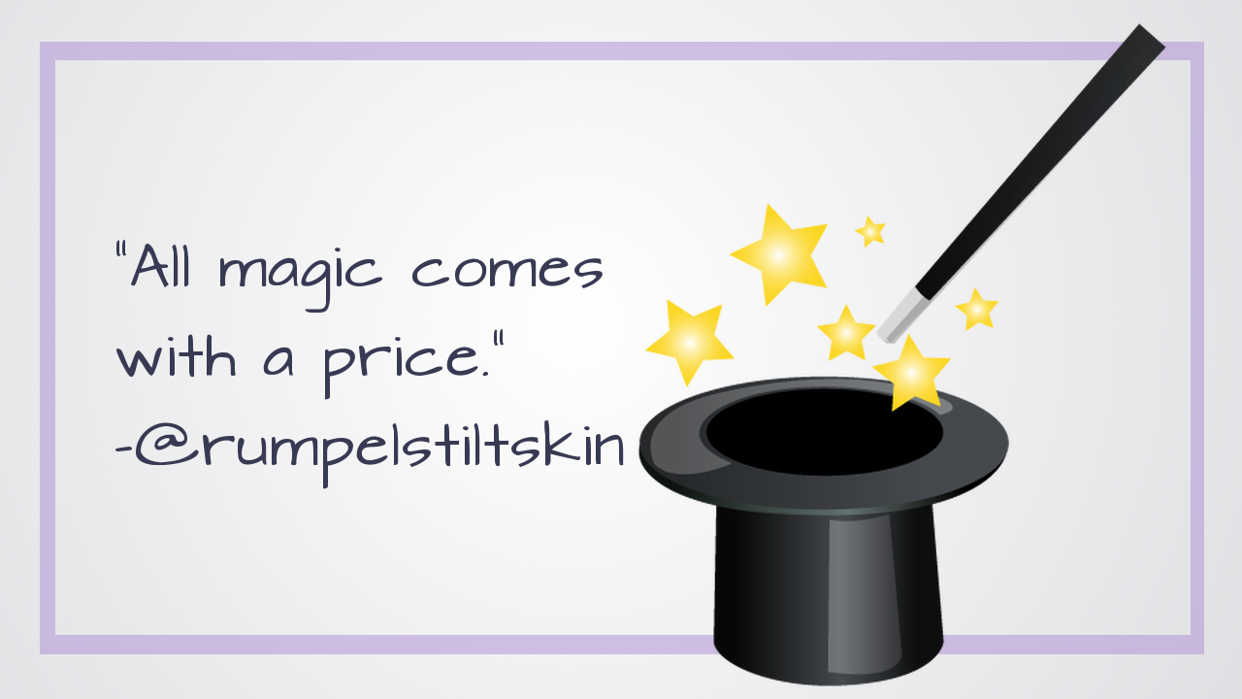
@jessrudder youtube.com/compchomp
Notes:
But we would have lost a lot of important, magical moments with other customers.

Slide 101

@jessrudder youtube.com/compchomp
Notes:
Similarly, there are times when the data we need from the database is complicated and being able to drop down to raw sql is the only straightforward way of getting it.

Slide 102

@jessrudder youtube.com/compchomp
Notes:
If ActiveRecord didn't allow this flexibility, it would be less and less useful as our apps got more and more complex. We'd spend a lot of time writing our own methods from scratch and (if the history of programming is any indication), we’d end up making an even bigger mess of things. And then our apps would be in the news for all the wrong reasons.

Slide 103
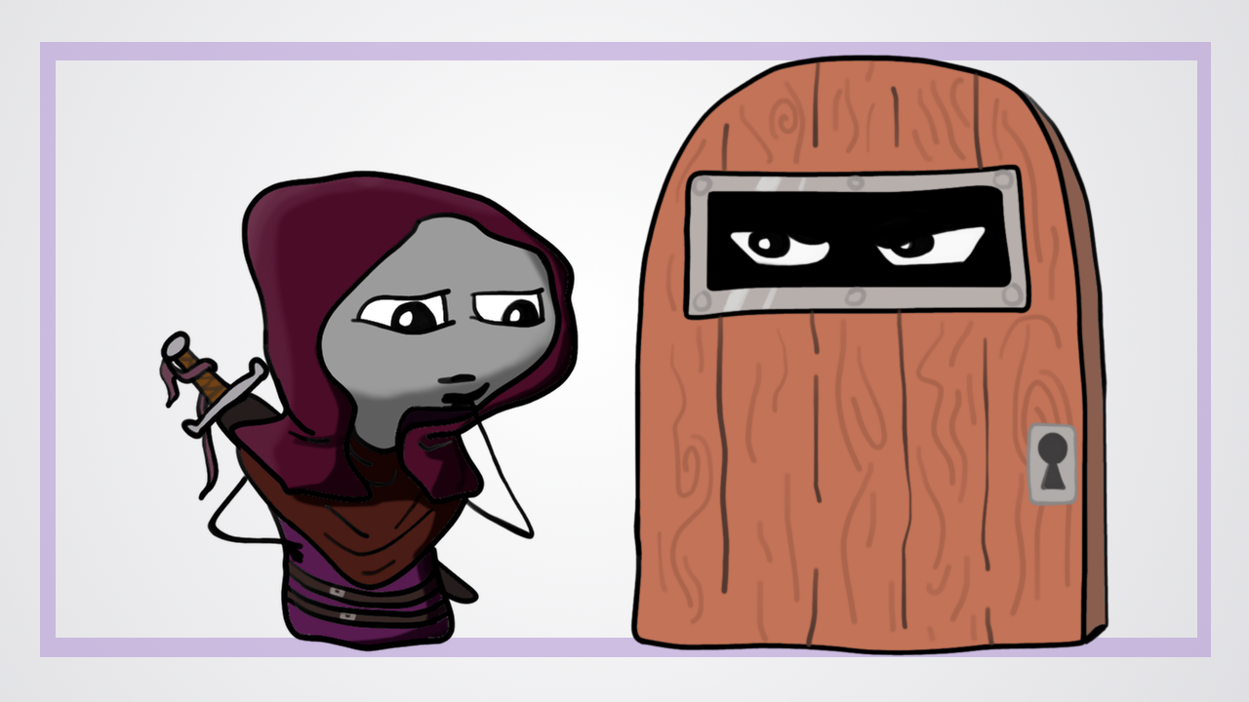
@jessrudder youtube.com/compchomp
Notes:
I know it’s a little bit tougher than ‘ye good olde days’ where security was a heavy wooden door guarded by a tough guy. We didn’t have to worry about automated attacks being run by three-year-olds looking for the slightest vulnerabilities in our code. It was a face-to-face interaction and you likely got one try to get it right.

Slide 104
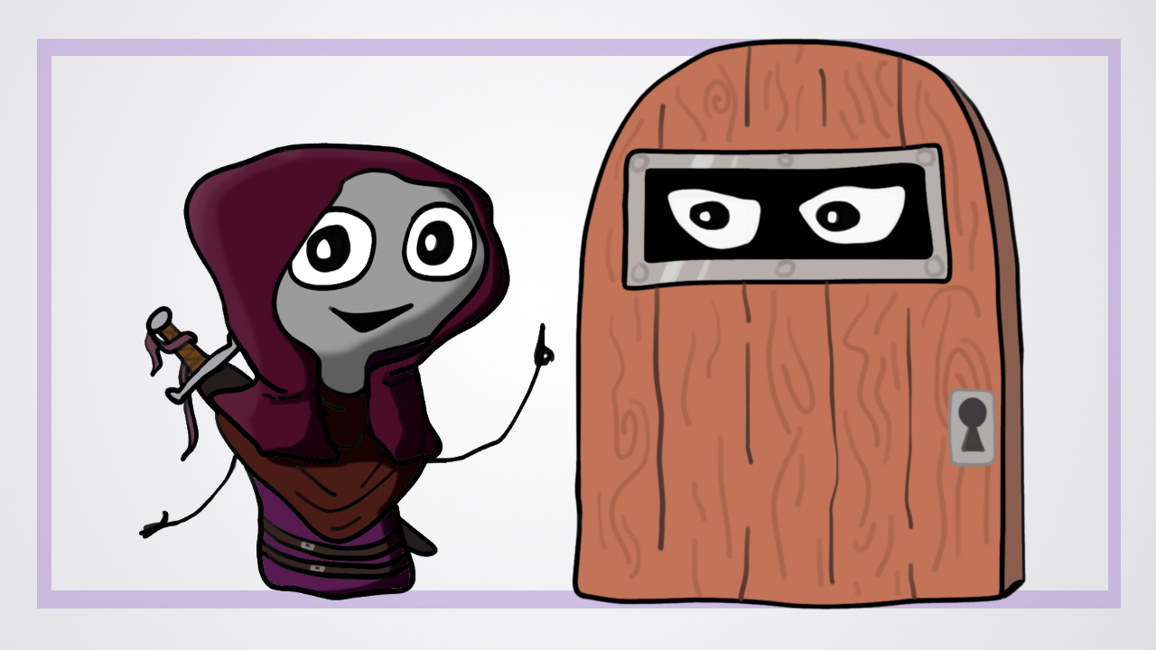
@jessrudder youtube.com/compchomp
Notes:
But, in reality, things aren’t really that much more complicated. With the built in security in Active Record and just a bit more knowledge of what’s going on behind the scenes in those helper methods, we can write code that will keep our customer’s data and our reputations safe and secure.

Slide 105
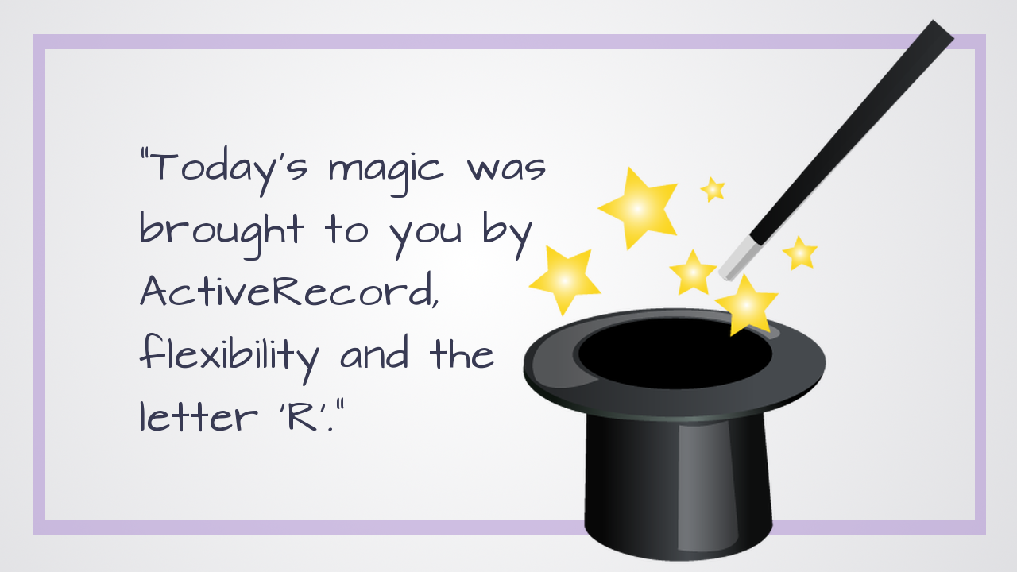
@jessrudder youtube.com/compchomp
Notes:
I’d like to give a quick shoutout to my colleague Eric Rafaloff whose Thursday code reading was the inspiration for this talk and my husband Josh for hand drawing anything I asked for AND double checking my sql. Coder/Animators are the best.

Slide 106
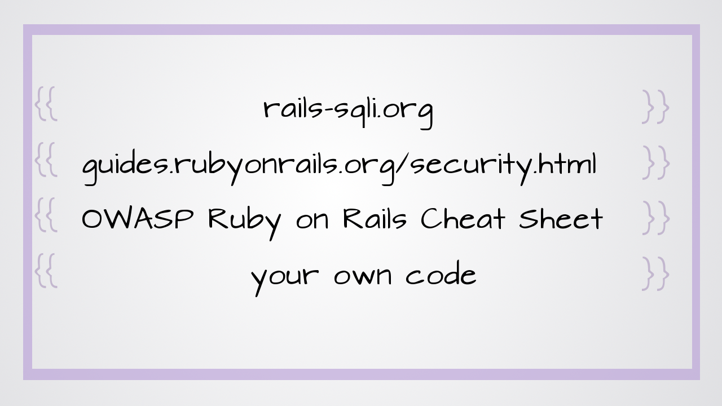
@jessrudder youtube.com/compchomp
Notes:
Here are some great resources if you’d like to learn more about sql injection and rails.

Slide 107

Notes:
As I mentioned, I’m Jessica Rudder. I make videos about code at youtube.com/compchomp – if you like code and videos, I’d love to have you check them out.
I’d also love to continue the conversation - I’m on Twitter @JessRudder
And, I’ve “borrowed” the company credit card in order to host a get together tonight for people that are new to coding. If you’re just starting out and you’d like to hear more about Learn or you want to meet some other beginners, hit me up after the talk and I’ll give you the
Thank you!

